Slide 2
% of Global HCV Seropositive Cases

Slide 3
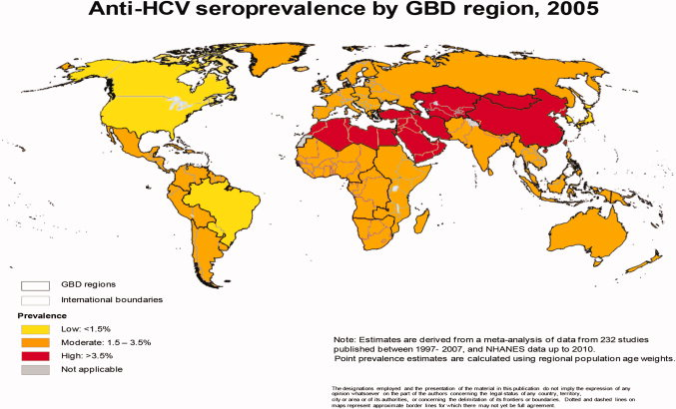
Global epidemiology of hepatitis C virus infection: New estimates of age‐specific antibody to HCV seroprevalence
Mohd Hanafiah, K. et al.57 (4) Hepatology, 2013

Slide 4
HCV Epidemiology in West Africa
Prevalence:
Most recent estimates: >2%
Limitations on estimates
Published studies: 0-45%
Limited, or no, population based studies
Based on serology (Ab test)
Over time, Serologic testing methods have changed
1st → 3rd generation ELISA assays
Rapid detection assays

Slide 5
HCV Epidemiology in West Africa
Incidence:
?
Severity of disease:
?
Level of chronicity
?
Transmission:
?
Hypothesized theories:
Contaminated needles
Medical or cosmetic based procedures (hospital or community based)
Association with HBV infection
Genotype distribution:
Limited data

Slide 6
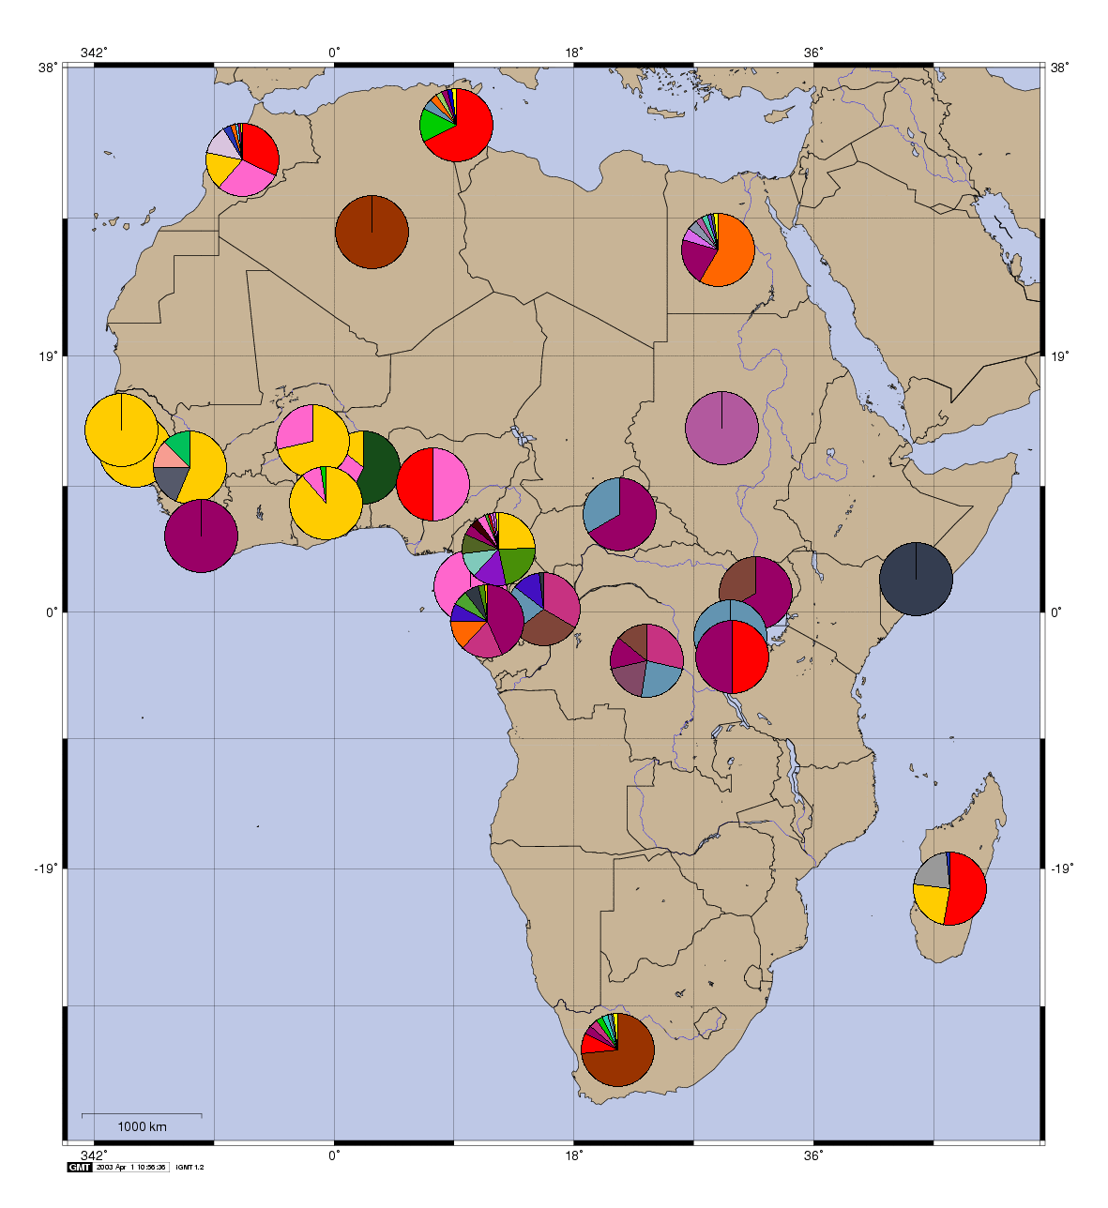
Genotype distribution from HCV Database (Los Alamos National Laboratory)

Slide 7
HCV Genotype Distributions LANL Database
Country | Genotype Distribution | Total N (viruses sequenced)
Ghana | 11.4% genotype 1 88.6% genotype 2 | 44
Nigeria | 100% Genotype 1 | 4
Burkina | 28.6% Genotype 1 71.4% Genotype 2 | 14
Cameroon | 40.0% Genotype 1 24.9% genotype 2 35.0% genotype 4 | 443
Uganda | 100% Genotype 4 | 9
Egypt | 98% genotype 4 | 957
South Africa | 11.6% genotype 1 14.6% genotype 2 73.4% genotype 5a | 267

Slide 8
Issues / unique findings identified from studies in Africa
Correct testing strategy to provide estimates
Estimates of seroprevalence?, clearance?
Need to account for assay sensitivity / specificity
High false positive rates or High spontaneous clearance rates?
Several studies: +Ab positive, HCV RNA negative
Higher rate than expected for spontaneous clearance
Low viral levels
Less severe disease?
Diversity of viral genotype distribution
Endemic for at least 500 years

Slide 9
HCV in Africa: Why Study?
Vastly understudied
Large burden of disease
Suspected, but not proven geographic origin of HCV
Long-standing host-viral relationship
Host / viral adaptation studies
Viral evolutionary process
Numerous ‘race’ based variations in HCV outcomes
Clearance of infection, natural history, treatment response

Slide 10
HCV in Africa: Why study?
Vast potential to study:
Host genomic factors associated with HCV outcomes
Host adaptation for HCV
Viral diversity / heterogeneity of HCV
Africa specific epidemiology
Allow for identification and control of epidemic
Allow appropriate studies on above aspects

Slide 11
Multi-Disciplinary Approach to HCV in Africa
Epidemiology
Molecular/
Diagnostic
Virology
Health Practitioners
Host Genetics

Slide 12
HepNet objectives
Over-riding objectives:
--establish a multi-disciplinary, structured ‘hepatitis network’ that will enhance our collective ability to address the fundamental questions surrounding the viral hepatitis epidemics in West Africa
--to enable the successful competition for grants that will address critical issues surrounding viral hepatitis in West Africa

Slide 13
Africa Based Sites and Experts / Investigators
Kumasi
Obuasi
Ibadan
Epidemiology
Virology
Host Genetics
Molecular / Diagnostic

Slide 14
Africa Based Sites and Experts / Investigators
Kumasi
Obuasi
Ibadan
LUMC
JHSPH
Duke
CDC
Cambridge

Slide 15
Current ‘Goals’ of HepNet
Establish / Strengthen collaborations
Multi-discipline
International
Establish HepNet communication routes
Inaugural meeting
August 12-13, 2013
Kumasi, Ghana

Slide 16
Growth of HepNet
Establishing Effective Network
Centers
Experts
Communication
Shared Resources / Data / Samples
Identifying Critical Questions

Slide 17
Current HepNet Protocols
METS Pilot Data
Nigeria Pilot Data
Kumasi Blood Bank Protocol
Obuasi Community Based Survey
HBV Vertical Transmission Feasability Survey
??

Slide 18
Planned Grants
HCV In Africa: Transmission and Host/Viral Genetic Study
Planned October Submission: NIH R01
Co-PI mechanism with LUMC as applicant institution
JHSPH: K Nelson
Duke: T Urban
CDC: J Forbi, Y Khadanov
Sanger/Cambridge: M Sandhu

Slide 19
HepNet Questions as we proceed thru meeting
What are the critical questions surrounding viral hepatitis in Africa?
What are the limiting factors to address and study such issues?
How can a multi-disciplinary approach be utilized to address these questions?’
How can HepNet foster collaboration and communication to enhance the collective ability to perform research and improve viral hepatitis control?

