Slide 1
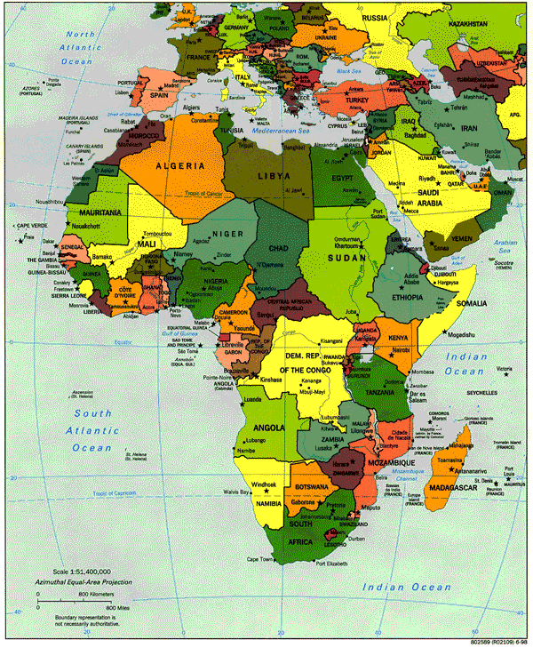
International Collaboration in Biomedical Research:
Two Perspectives
Amy Luke, PhD &
Jacob Plange-Rhule, MD, PhD
HepNet, Kumasi 12 Aug 2013

Slide 2
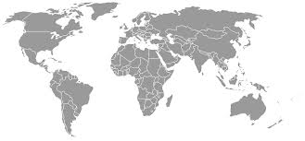
International Collaborative Study of Hypertension in Blacks (ICSHIB)
Richard S. Cooper, PI 1991-2008
Chicago, USA
Ibadan, Nigeria
Yaounde, Cameroon
Kingston, Jamaica
Bridgetown, Barbados
Castries, St. Lucia
Manchester, UK
>10,000 participants enrolled
Third renewal - top extramural score of the year
>200 publications
Launched careers of multiple researchers - Kaufman, Rotimi, Luke, Adeyemo, Zhu, Tayo….

Slide 3
ICSHIB provided the paradigm and infrastructure for numerous NIH-funded research projects, educational and training collaborations and untold number of friendships….
Multiple genetic studies – hypertension, obesity
Hypertension intervention
ICSHIB
Multiple epi studies -
hypertension, obesity
Genetics & epi -kidney disease
Genetics & epi –
sickle cell disease
Multiple formal (ie, Fogarty) & informal education & training exchanges

Slide 4
Current NIH-funded research projects:
RO1 HL53353 (Cooper) 9/95 – 4/14
Genetics of Hypertension in Blacks
R03 TW008695 (Cooper) 7/11 – 6/14
Variation in Severity of Sickle Cell Disease among the Yorubas
R01DK080763 (Luke) 4/09 – 3/14
Modeling the Epidemiologic Transition Study: Energetics, Obesity and CVD in African Populations
U54HG006939 (Ojo and Adu) 7/12 – 6/17
H3Africa Kidney Disease Research Network
R01DK090360 (Durazo) 9/11 – 7/16
Determinants and Consequences of Low Vitamin D in Populations of African Descent
1UO1 HL114198 (Ogedegbe) 5/12 – 4/16
Task Shifting and Blood Pressure Control in Ghana

Slide 5
Current (and future) education and training programs:
TW009140 (Ogedegbe, Tayo & Adanu) 9/11 – 8/16
NYU/Univ of Ghana Cardiovascular Research Training Institute Program
Center for Research & Training, University College Hospital, University of Ibadan (UCH/Loyola/NYU) – initiated 2012
Afro-Med eCapacity grant application (Cooper & Tayo) - under review (NIH) – UCH/Loyola
Senior medical student exchange between KNUST and LUC (Plange-Rhule & Luke) 2011 – present
Exchange of faculty – in development - Dept of Public Health, UCH, Ibadan; School of Public Health, University of Ghana; LUC

Slide 6


Slide 7
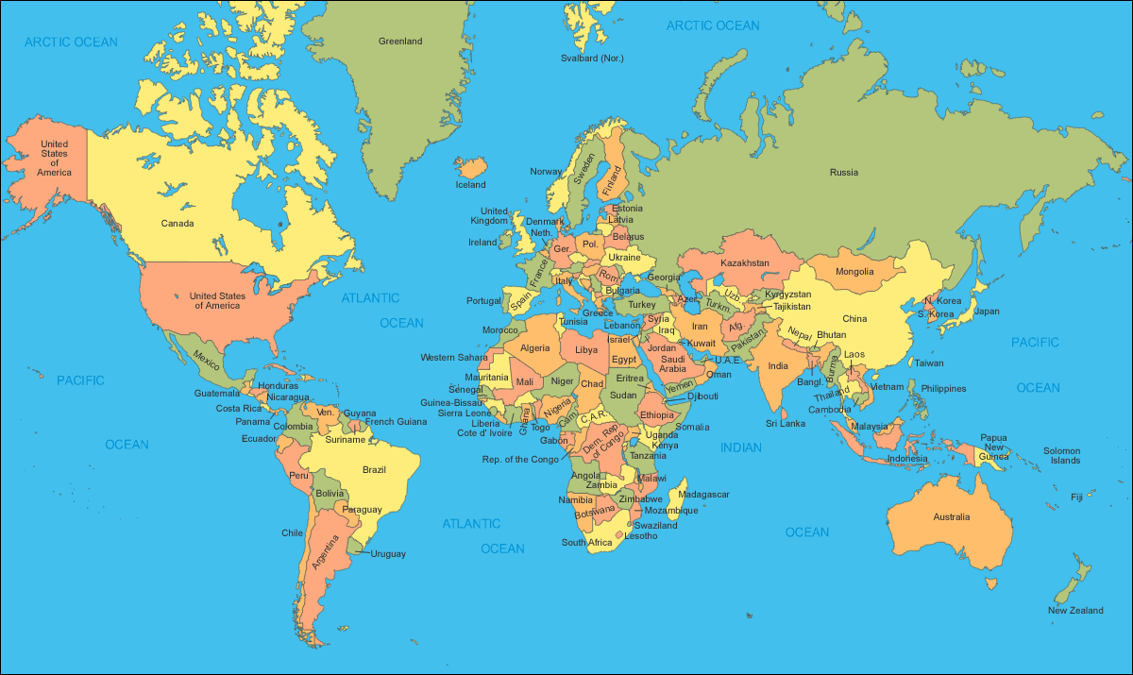
METS study sites

Slide 8
Institutions & Investigators
Loyola University Chicago – Amy Luke, Lara Dugas,
Ramon Durazo-Arvizu, David Shoham, Richard Cooper
Kwame Nkrumah University of Science & Technology, Kumasi, Ghana – Jacob Plange-Rhule, Collins Kokuro, Frank Micah
University of the West Indies, Mona, Kingston, Jamaica –
Terrence Forrester
Ministry of Health, Victoria, Seychelles – Pascal Bovet (Univ. of Lausanne)
University of Cape Town, Cape Town, South Africa – Vicki Lambert
University of Wisconsin, Madison, WI, USA – Dale Schoeller
Consultants: Soren Brage (MRC, Cambridge) &
Ulf Ekeleund (Norway Institute of Health)

Slide 9
Underlying Rationale for METS
Prevalence Women Men
Ghana South Africa Jamaica Seychelles US
Lower middle HDI
Very high HDI

Slide 10
Study Design
Random selection of participants based on local design
Enrollment and baseline assessment of medical history, socioeconomic indicators, energy expenditure, physical activity, dietary intake, body composition, blood pressure and blood draw, spot urine collection
Year 1 follow-up – weight, blood pressure and changes to health history
Year 2 follow-up – repeat of baseline measurements
Year 3 follow-up – repeat of baseline measurements plus 24-hour urine collection, DXA, plasma vitamin D assessment
Year 4 – repeat year 2 measurements
VITAMIN D ANCILLARY STUDY

Slide 11
Distribution of Body Mass Index by Site & Gender
Men
Women

Slide 12
Manuscripts from Baseline Data to date….
Published:
Protocol paper – BMC Public Health 2011
Body composition methodology – Eur J Clin Nutr 2013
Seychelles dietary intake – Eur J Clin Nutr 2013
Under review:
Baseline physical activity – Int J Behav Nutr Phys Act
Vitamin D descriptive – Am J Clin Nutr
Bis-phenol A in Ghana, Jamaica and US – Environ Health Perspect
Under-reporting of dietary intake – Brit J Nutr
Close to submission:
Phys activity patterns (Dugas)
SES and phys activity (Shoham)
Blood pressure descriptive (Forrester)
Diet variety and obesity (Dugas)
In preparation:
Lipids descriptive (Luke/Cooper)
Resting metabolism and smoking (Bovet)
Total energy expenditure and phys act (Luke)
Vitamin D and obesity (Durazo-Arvizu)
Dietary patterns (Luke)

Slide 13
Grants derived from METS to date….
Funded:
VIDA (Vitamin D Ancillary Study) – Durazo-Arvizu, PI - in 3rd year of 5
Submitted:
IR5 (Insulin Resistance in 5 Countries Study) – Dugas & Goedecke, MPI - R01 submitted June 2013
In Preparation:
Heavy Metals and Health in METS – Luke & Ettinger, MPI - R21 to be submitted Oct 2013
Oxidative Stress, Alcohol and Bone Health – Dugas, PI - R21 to be submitted Oct 2013
METS competitive renewal – Luke, PI – to be submitted Feb/June 2014

Slide 14


Community-Based Dietary Salt Intervention for Hypertension Prevention
KNUST, Kumasi - St George, University of London Collaboration
1996 -Date
J. Plange-Rhule: Kwame Nkrumah University of Science & Technology, Kumasi
Francesco Cappuccio: St George’s, University of London
John B. Eastwood: St George’s, University of London
Frank Micah: Komfo Anokye Teaching Hospital, Kumasi

Slide 15
Hypertension Detection, Control and Management by locality
Hypertension Detection, Control and Management by locality
**
Rural (n=481)
Semi-urban (n=532)
*
**p<0.001; *p<0.01
%
*
≥140and/or ≥ 90
Detected
Treated
Controlled
Hghghgghgh
Gjggj
Notes:
This graph measures the percentage of hypertensive individuals who were detected, treated, or controlled by gender and age group. The treatment and controlled rates were very low in both rural and semi-urban communities.

Slide 16
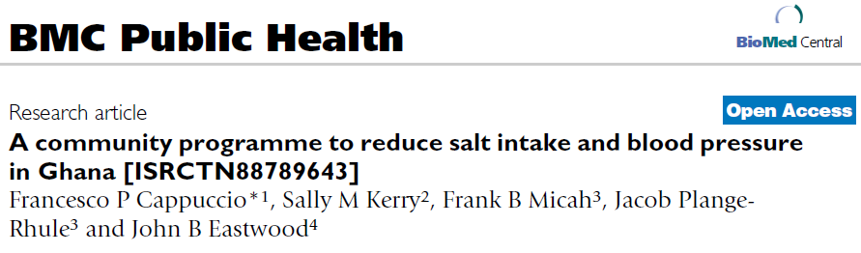
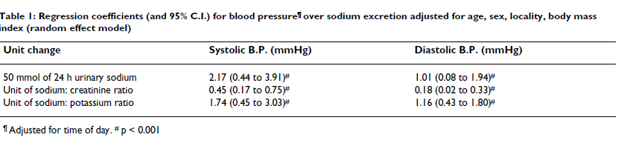

Slide 17
Publications
Total: 22
Investigators Ghana: 46 UK: 63

Slide 18
Task Shifting and Blood Pressure Control in Ghana:
A Cluster Randomized Trial
Investigators: Gbenga Ogedegbe, MD, MPH, MS; Jacob Plange-Rhule, MD; Richard Cooper, MD
NIH/ NHLBI 1U01HL114198-01

Slide 19
STUDY RATIONALE
Epidemic of cardiovascular diseases (CVD) in countries in sub-Saharan Africa (SSA).
  SSA bears 24% of the global disease burden but only 3% of the global health workforce.¹
  75% of deaths in SSA will be attributable to hypertension by 2020.²
  Blood pressure (BP) control is essential in reducing hypertension-related morbidity and mortality.
  Poor prevention due to socioeconomic barriers, lack of insurance coverage, uncoordinated care, and shortage of physicians.
  Task-shifting of primary care duties from physicians to non-physician health care providers
  1. Anangwe SC, et al. Int J Environ Res Public Health. 2007 Jun;4(2):93-100.
  2. Kearney PM, et al. Lancet 365: 217-223.
Hghghgghgh
Gjggj

Slide 20
OBJECTIVES
Primary:
To evaluate the effect of the WHO Package targeted at CV risk assessment versus provision of health insurance coverage, on BP reduction.
Secondary:
To evaluate the effect of the WHO Package vs. provision of health insurance coverage on BP control.
To evaluate the effect of the WHO Package vs. provision of health insurance coverage on lifestyle behaviors.
To evaluate sustainability of the intervention effects one year after the trial is completed.
Hghghgghgh
Gjggj

Slide 21
RESEARCH DESIGN
Overall Study Design
32 Community Health Centers are randomized with 20 patients
per site for a total of 640 patients
Control Group (16 CHCs)
Intervention Group (16 CHCs)
All Patients Receive National Health Insurance Coverage
All Patients Receive National Health Insurance Coverage
Intervention
CV risk assessment;
- BP readings;
- Medication adjustment;
- Behavioral counseling
Receive Usual Care
Receive WHO Package delivered by CHW
Follow-up at 3, 6, 9 &12 mos.
Follow-up at 3, 6, 9 &12 mos.
Final Outcome Assessment
BP Measurement (24 mos.)
Final Outcome Assessment
BP Measurement (24 mos.)
Recruitment to date:
16 facilities
349 patients
Hghghgghgh
Gjggj

Slide 22
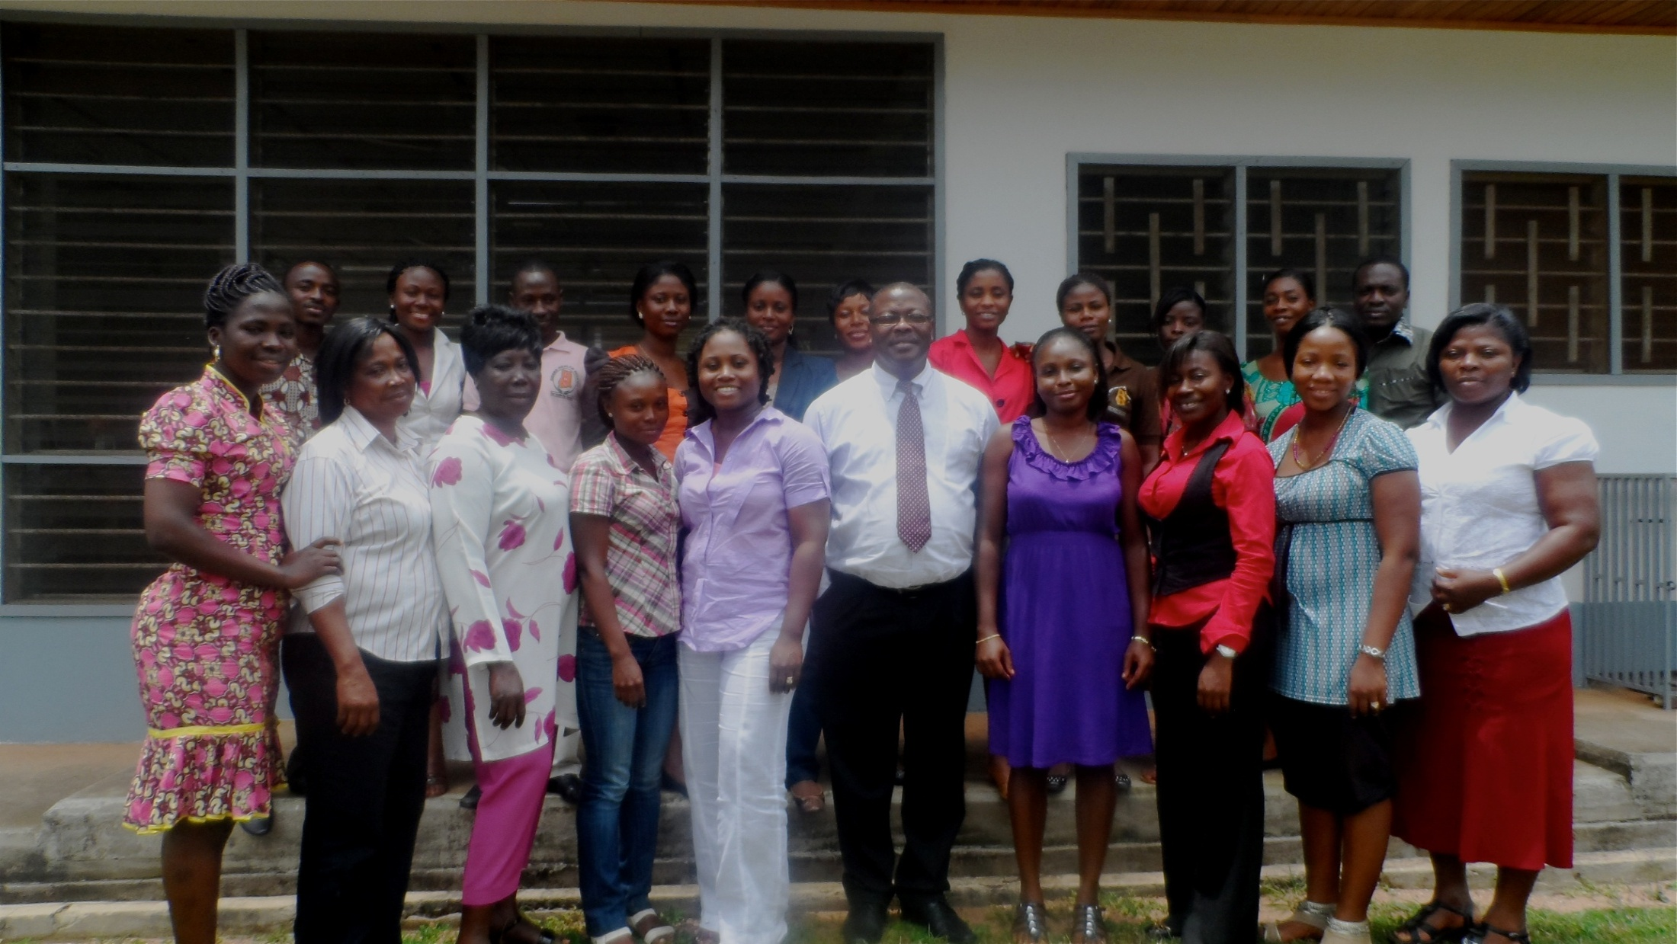
PARTICIPANTS AT TRAINING WORKSHOP
Hghghgghgh
Gjggj

Slide 23
H3Africa Kidney Disease Research Network (U 1U54HG006939-01)

Slide 25
Institutions and Collaborators
Country | Institution | Key Personnel | Role
Ethiopia | Addis Ababa University | Y. Menghistu | Center PI
Ghana | University of Ghana | Dwomoa Adu, Charlotte Osafo Alexander Nyarko Michael Mate-Kole Ivy Ekem Vincent Boima Kwame Affram | PI
 | Kwame Nkrumah University of Science & Technology | Jacob Plange-Rhule Benjamin Eghan Yaw Adu-Boakye Elliot Tannor Dr Sampson Antwi | Center PI
Kenya | University of Nairobi | S.O. Mc’Ligeyo James Ochanda Joel W. Ocheng Isabella Oyier | Center PI

Slide 26
Institutions and Collaborators
Country | Institution | Key Personnel | Role
Nigeria | University of Ibadan | Tunde Salako Olukemi Amodu Adebowale Ademola Akinkemi Fedipe | Center PI
 | University of Ilorin | Chijioke Adindu Timothy Olarenwaju C. O. Bewaji
 | Obafemi Awolowo University | Fatiu Arogundade
 | University of Abuja | Samuel Ajayi Manmak Manven
 | University of Nigeria, Enugu | Ifeoma Ulasi Chuba Ijoma
South Africa | University of Western Cape (SANBI) | Nicki Tiffin Junaid Gamiedien

Slide 27
H3Africa Kidney Disease Research Network
Country | Institution | Key Personnel | Role
Israel | Technion – Israel Institute of Technology, Rappaport Research Institute | Karl Skorecki Walter Wasser
U.S. | Loyola University | Richard Cooper Bamidele Tayo | Center PI Stat. genetics
 | Duke University | Rasheed Gbadegesin | Molecular genetics
 | University of Michigan | Akinlolu Ojo Matthias Kretzler Michael Boehnke John Moran David Burke Daniel Clauw Frank Brosius | PI Stat. genetics Genetics Genetics TAG TAG
 | NHGRI | Adebowale Adeyemo
 | NIDDK | Jeffrey Kopp
 | Harvard University | Martin Pollak
Canada | University of Toronto | Rulan Parekh

Slide 28
ESKD PHENOTYPES ASSOCIATED WITH APOL1 GENETIC VARIATION (G1 and G2) IN AFRICAN AMERICANS
Hypertensive nephropathy
Non-monogenic Focal Segmental Glomerulosclerosis
HIV associated nephropathy
Sickle cell nephropathy
Earlier onset of ESKD

Slide 29
WHAT IS KNOWN IN AFRICA
CKD is common in Africa and occurs at an earlier age than in the USA or Europe
In Yoruba from Nigeria, the allele frequency of G1and G2 is 46% and 7%, respectively
In Ghana the allele frequency of G1 is 41% and in Ethiopia is 0%

Slide 30
Functional Composition of the Research Network
Research Projects
Training & Career Development
Infrastructure
Project I
Single gene mutations I
Track 1
Genomics-Focused Clinical Research
Genomics Research Labs
Project II
APOL1/MYH9
Track 2
Advanced Clinical Research
Bioinformatics/Data Management
Track 3
PhD and MSc
Biorepository
Project III
GWAS of disease loci
Track 4
Laboratory Technicians
Central Biochemical Lab
Project IV
Single gene mutations II
Track 5
Grant Management
Track 6
Short-term Faculty Sabbaticals

Slide 31
Research Projects in the H3Africa Kidney Disease Research Network
H3Africa Initiative
H3Africa Kidney Disease
Research Network
Monogenic
Disease
Childhood Onset NS
(N=50 families)
GWAS
Renal Candidate Genes
(MYH9, APOL1, etc)
Studies
(N=8000)
Longitudinal Cohort Study
(N=3150)

Slide 32
Epigenetic mechanisms, stunting and poor growth; targets for interventions
(OPP1066846)

Slide 33
Institutions & Investigators
University of Auckland, New Zealand
  Sir Peter Gluckman
  Allan Shepard
Kwame Nkrumah University of Science & Technology, Kumasi, Ghana
  Jacob Plange-Rhule
University of the West Indies, Mona, Kingston, Jamaica
  Terrence Forrester
  Michael Boyne

Slide 34
Study Rationale
Stunting in early childhood pre-disposes to obesity, diabetes and other CVDs in adulthood
Identification of epigenetic patterns and mechanisms specifically associated with stunting in Jamaican and Ghanaian populations will enable development of interventions to be applied to at-risk populations

Slide 35
Study Objectives
Objective 1: To identify epigenetic marks and the associated affected molecular pathways that are specific to stunting and/or IUGR, and provide information on the relative importance of prenatal versus infant nutrition
Objectives 2: Identify those marks that are nutritionally sensitive and related to growth
Objective 3: Use in vitro studies to elucidate pathways involved and their nutritional regulation.
Objective 4: Test the relationship between maternal nutrition and epigenetic changes in infancy and the relationship between these changes and the development of stunting by birth or in infancy.

Slide 36
For collaboration to be successful….
Committed Individuals at both ends
Equal partners
Equality of input; Equality of outputs
Trust on all sides
Transparency
In agreement on research fundamentals
Patience / Equanimity
Flexibility
Realistic expectations
Good communication
Savvy on the ground….
Friendship – not required but really helpful
Vision of long-time scale
Must learn to deal with…
Frustration
Priority differences
Management-style differences
Communication difficulties
Likely deal breakers….
Under-funding
Disagreement over data interpretation / ownership
Non-acknowledgment of contributions
Dishonesty

