Slide 1
Introduction to the Assessing Clinical Ethics Skills (ACES) Evaluation Tool
Katherine Wasson PhD, MPH
Associate Professor
Neiswanger Institute for Bioethics
Loyola University Chicago

Slide 2
Why do we need Clinical Ethics Consultants?
Complexity of Health Care
Death Denying Societies
  Difficult decisions
  Values conflicts
  Moral distress and suffering
CEC role includes:
  Identify and Clarify Ethical issues
  Facilitate ways forward – ethically justifiable options

Slide 3
Professionalization
US developing standards in clinical ethics consultation
CHA Striving for Excellence
ASBH Quality Attestation – knowledge and skills
  April – July 2017 Approved Certification Process
  http://asbh.org/professional-development/hcec-certification

Slide 4
Professionalization
How to teach and assess interpersonal skills
  Loyola: develop assessment tool for simulated ethics consultations
  Use simulated ethics cases to rate CEC’s performance on competencies
  Website to train participants how to use the ACES evaluation tool
Provides framework and demonstrates specific skills
May increase understanding of content of ethics consultations

Slide 5
Assessing Clinical Ethics Skills (ACES) Tool
Assessing Clinical Ethics Skills (ACES) Tool
  4 Bioethicists + Medical Education assessment expert
    ASBH Core Competencies
    Veterans Affairs (VA) Ethics Proficiency Assessment Tool
  Developed Expert Agreement on ACES content
  Extensive Rater Training
  Spring 2015 launched website
  Spring 2017: Pass/Fail score set by 4 internal + 4 external experts
    Reliability and Validity of items on tool = superior

Slide 6
Participant Demographics
White (87%), female (61%), 55-64 (41%)
Roman Catholic (42%) or Protestant (28%)
Academic Medical Center (42%), Community Hospital (59%)
Role
  CEC 30.0%
  Chaplain 14.4%
  Physician 16.7%
  Staff Nurse 5.6%
  Nurse Mgr 7.8%
  Educator 24.2%
  Administrator 10.0%

Slide 7
ACES Tool Introduction
Overview of Rating/Scoring
  Actions/behaviors to observe
  Default: if it happens in consult, CEC “gets credit”
  Examples – values, moral views, disagreement
  Exception = Question 8
    Educate Participants regarding the Ethical Dimensions of the Case
    Ethics Consultant must be active and articulate elements of item

Slide 8
Ethics Case Simulations
Case: Mrs. Henderson
  78 y/o woman with 7 cm right-sided ischemic stroke
  Intubated and transferred to medical center for surgical evaluation
    Not an candidate for neurosurgery
  Prior to stroke, patient was very active, independent
  Cared for sister-in-law with stroke in past
  Daughter Patti wants to withdraw now
    Patient “wouldn’t want to live like this”
  Physician thinks it is too soon and wants 7 days to see if patient will recover

Slide 9
ACES Demonstration
https://lucapps.luc.edu/clinicalethics
http://hsd.luc.edu/bioethics/ethicsconsultskills/

Slide 10
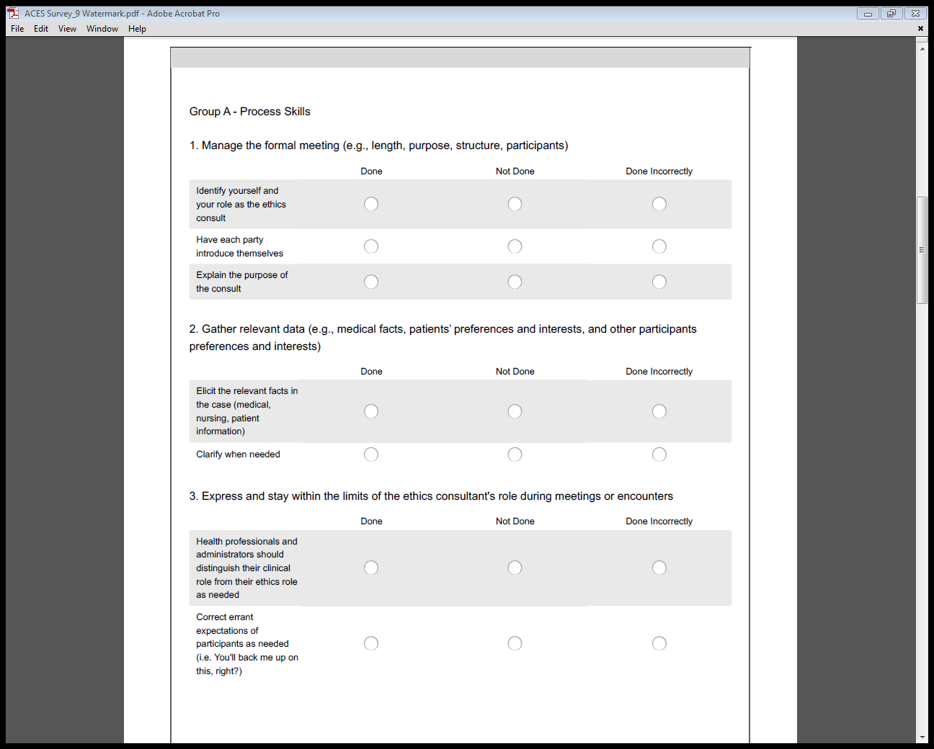

Slide 11
Discussion

Slide 12
ACES Team
Katherine Wasson, PhD, MPH (kawasson@luc.edu)
Mark Kuczewski, PhD
Michael McCarthy, PhD
Rejoice Jebamalaidass, MBA
Robert Johnson, MEd
Kayhan Parsi, JD, PhD
Viva Siddall, MS, MS, RRT, RCP
William Adams, PhD (c)
https://lucapps.luc.edu/clinicalethics
http://hsd.luc.edu/bioethics/

Slide 13
Viewing of an Ethics Consultation Simulation:
The ACES tool continued

Slide 14
ACES Tool Continued
Stroke Case Scenes 2-3
https://lucapps.luc.edu/clinicalethics

Slide 15
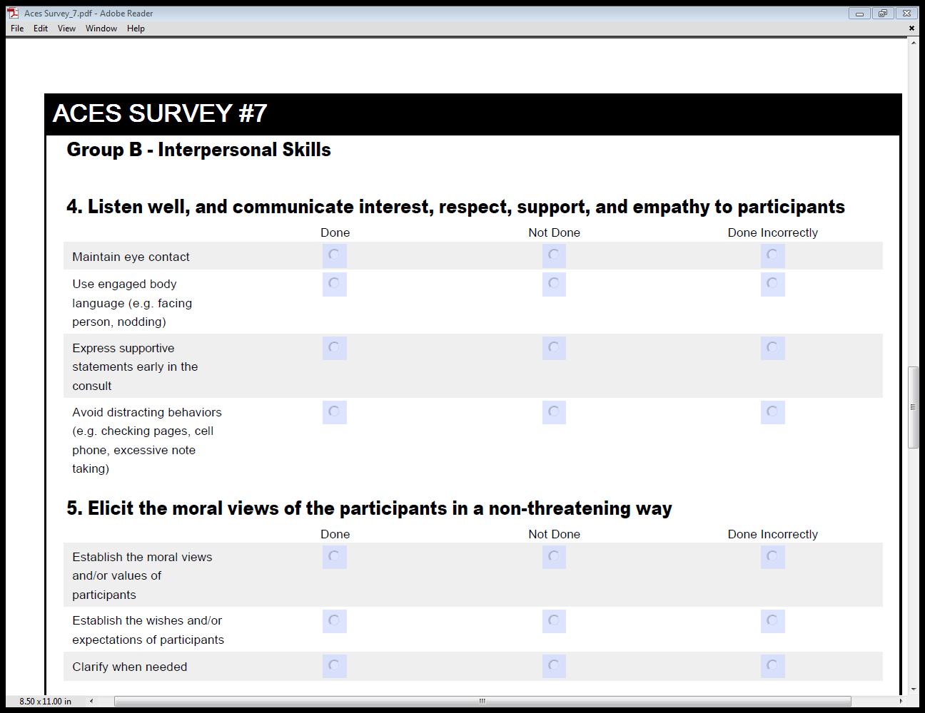

Slide 16
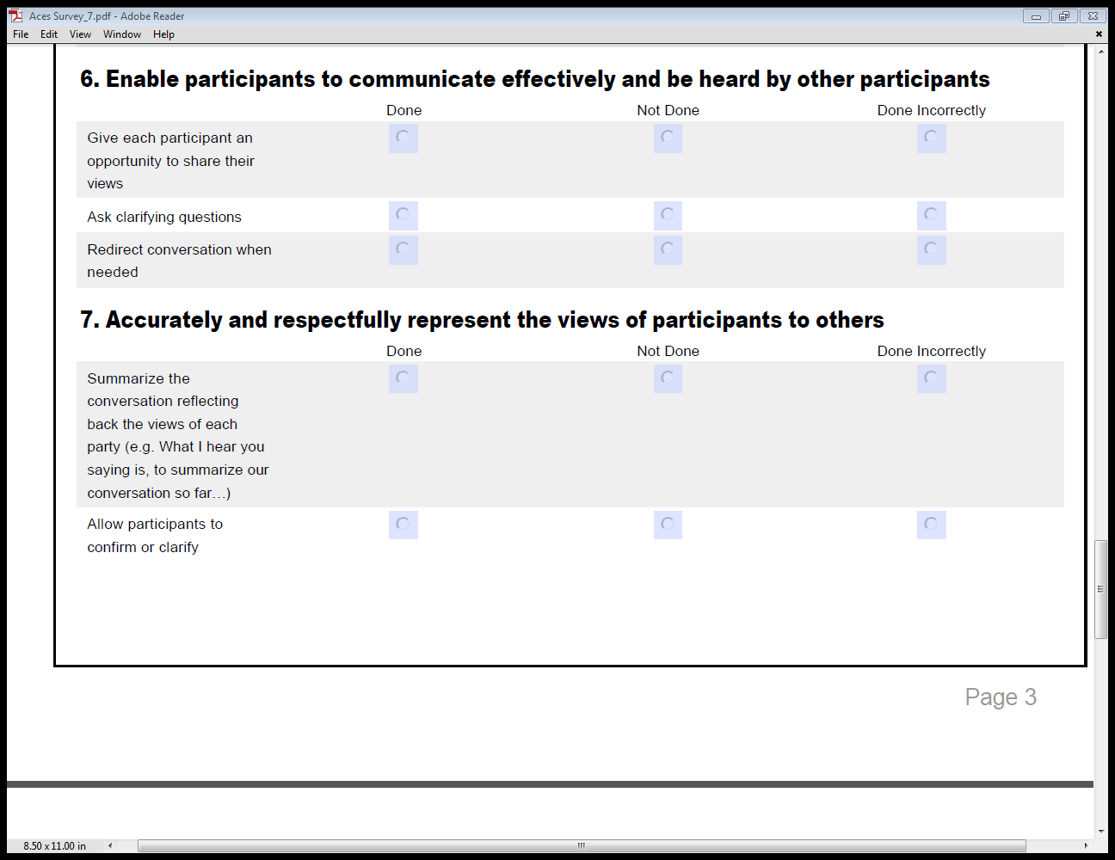

Slide 17
Discussion
How did the clinical ethicist do?

Slide 18
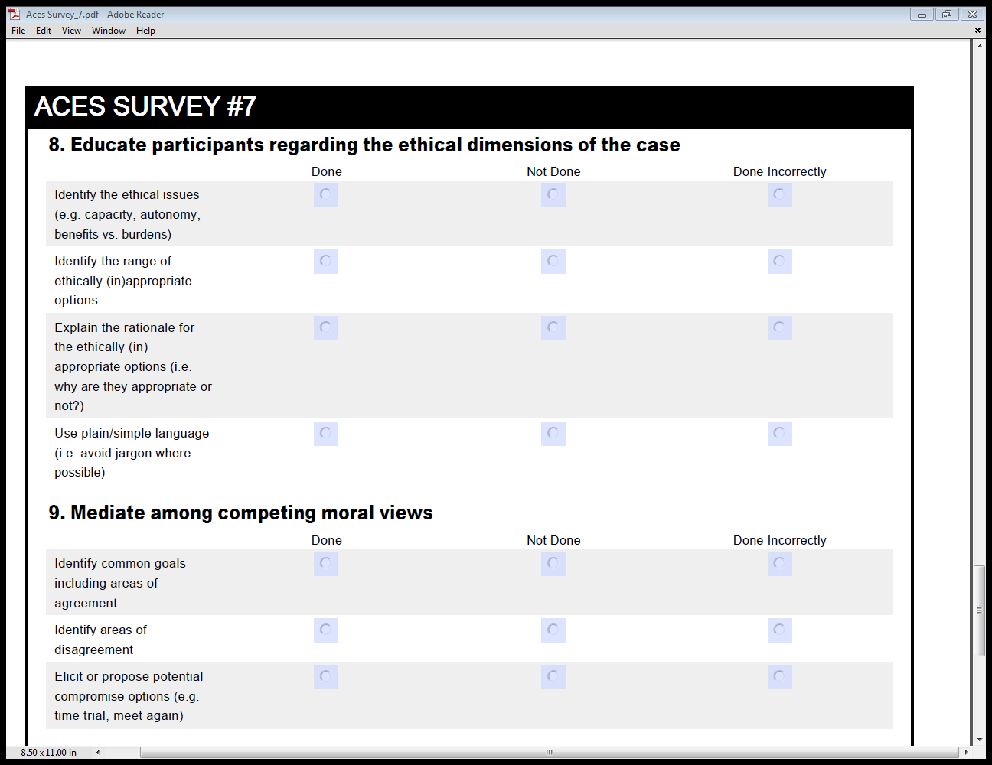

Slide 19
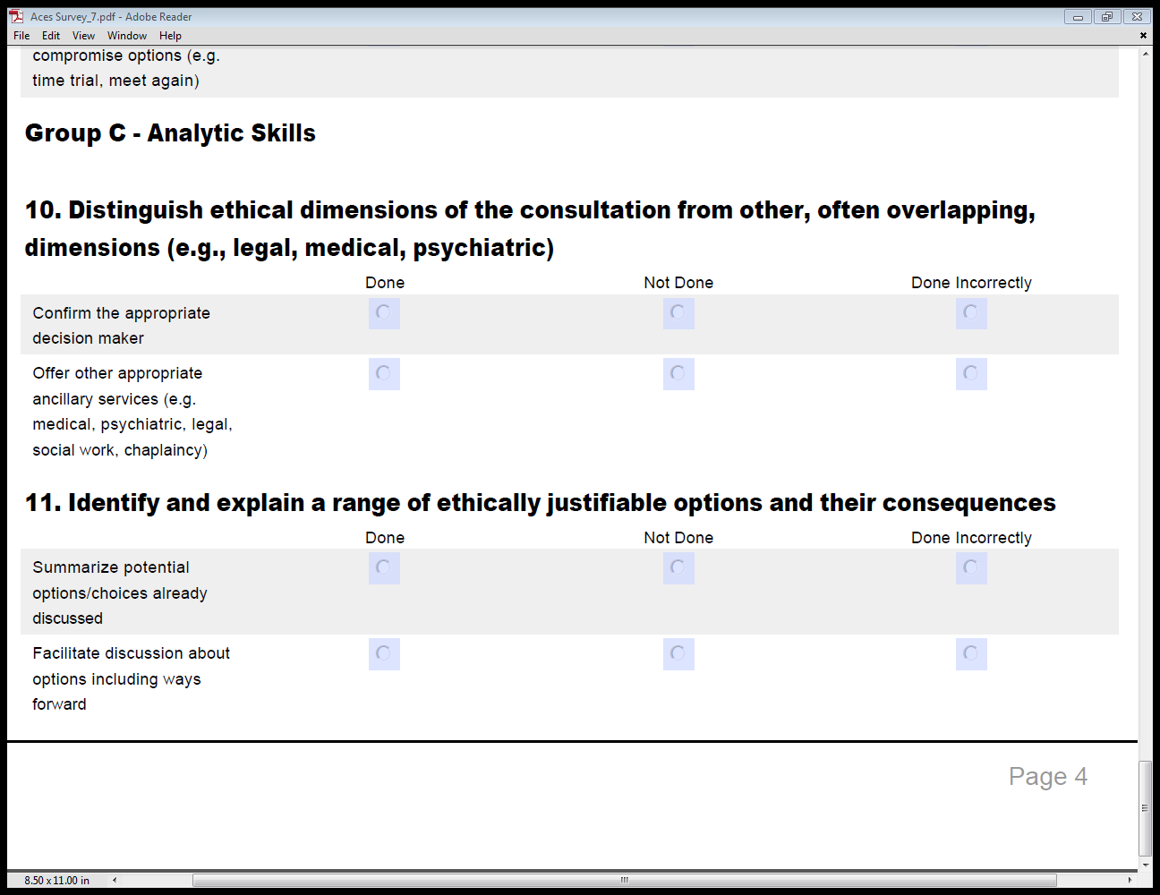

Slide 20
Conclusion
Clinical ethics consultation is a key service in addressing ethical issues
  Need clear standards and rationale
  Need quality training – theory and practice
  ACES tool is one approach to teach these skills
  http://hsd.luc.edu/bioethics/ethicsconsultskills/
  kawasson@luc.edu

Slide 21
References
American Society for Bioethics and Humanities (ASBH). 2011. Core Competencies for Health Care Ethics Consultants, 2nd Edition. Glenview, IL: ASBH.
U.S. Department of Veterans Affairs, National Center for Ethics in Health Care. 2014. Ethics Consultant Proficiency Assessment Tool. Available at: http://www.ethics.va.gov/integratedethics/evaluation.asp
Wasson K, Parsi K, McCarthy M, Siddall VJ, Kuczewski M. Developing an evaluation tool for assessing clinical ethics consultation skills in simulation based education: The ACES project. HEC Forum 28:217-28.
Wasson K and Kuczewski M. The Duty of Competence and the Role of Simulated Ethics Case Consultation. The American Journal of Bioethics. 15(5) 58-9, 2015.

